Slide 1
Answering the Auditor’s Call with Automation
Notes:
2533clscls

Slide 2



Andy
Levy
He/Him
Sr. Data Platform Engineer
SS&C Advent
PowerShell fan zealot
In IT since last millennium
Web dev & server administrator
Systems integrator
Database developer
DBA
https://FLXsql.com
alevyinroc
andy@FLXsql.com

Slide 3

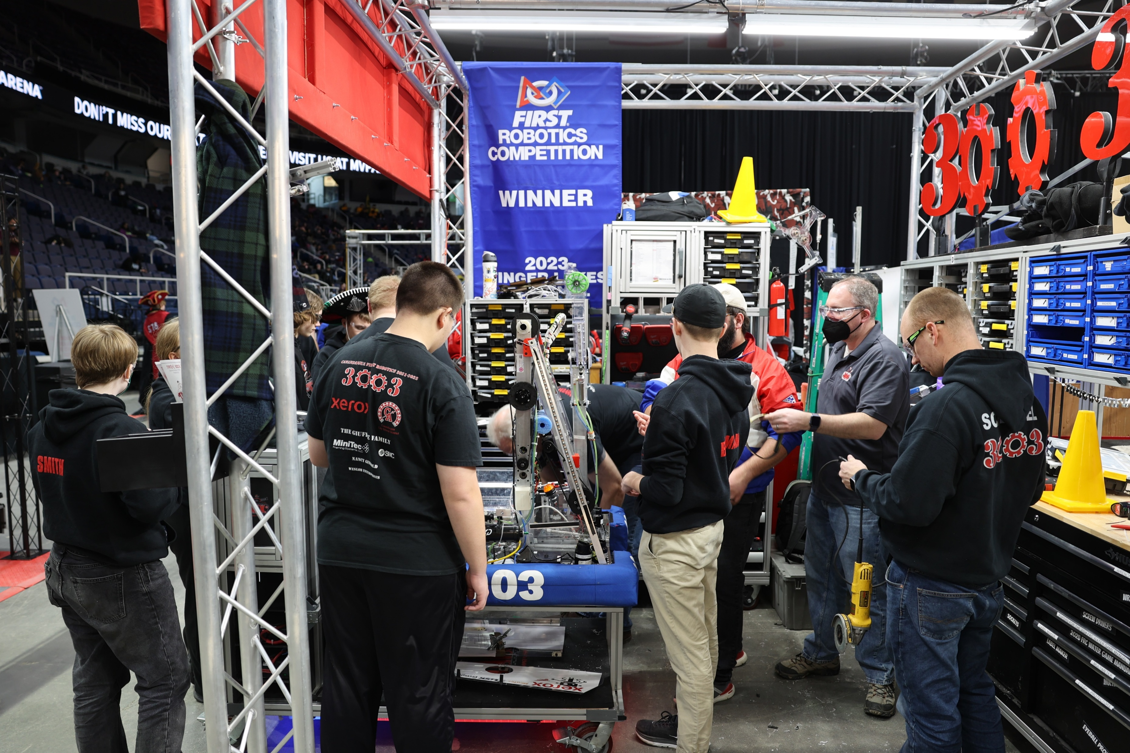
if ($CurrentActivity -ne 'Work')

Slide 4
What Are We Covering?
Common things Infosec & auditors ask for
Documenting that we do the things we say we do
Making the process faster, repeatable, and less painful

Slide 5
What Are We Skipping?
Your specific requirements
SQL Audit
Licensing
Notes:
Each company has their own requirements around auditing, inventory, alerting, etc. This talk is meant to give you tools and a starting point so you can more efficiently and effectively answer questions
SQL Audit is its own thing. Josephine Bush (https://sqlkitty.com) has some good talks on SQL Audit
We aren’t doing this to make sure your licensing is all correct. Though you can use some of the data we’re collecting for that purpose

Slide 6
Questions I’ve Been Asked
What SQL Server instances do we have?
Are we up to date on patching?
Can we watch the ErrorLog?
Who can access SQL Server?
Are we using encryption?
Is our data backed up?
Are integrity checks performed?
Provide a narrative of how the information was collected
Notes:
Including versions & patch levels
Integration with SIEM (Security information and event management)
Backups – this includes restore tests!

Slide 7
Why Automate?
Save time
Repeatable
Code provides the narrative
So I can do the things I want to do

Slide 8
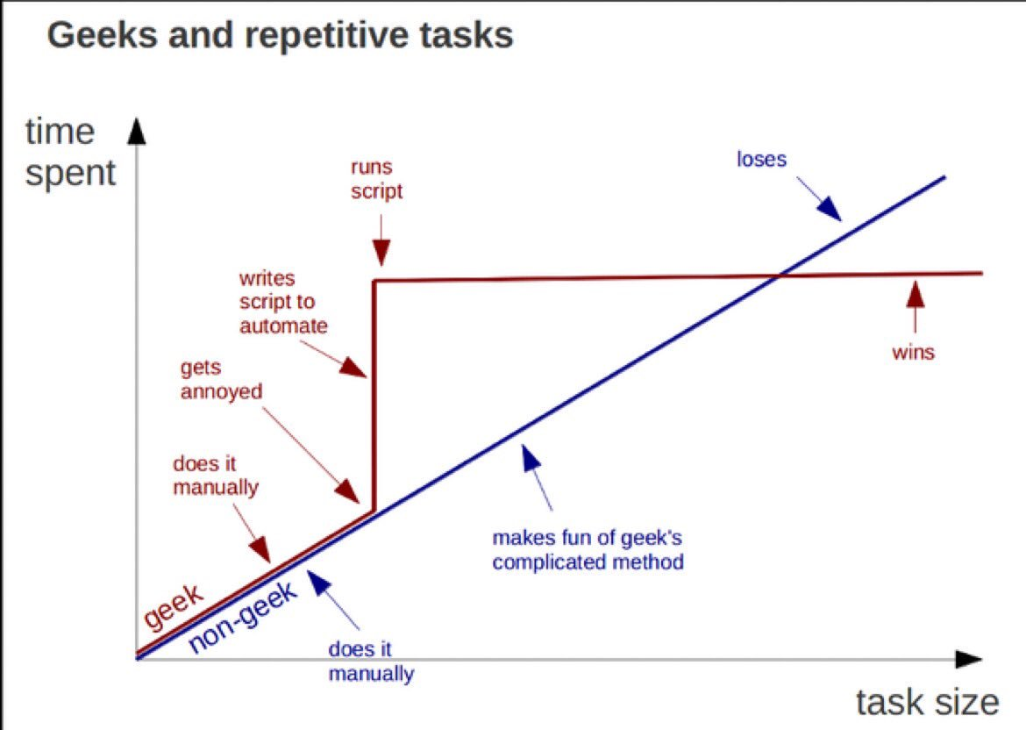
Source: https://twitter.com/kirkdborne/status/804145411997007873

Slide 9

Is dbatools Safe?
Signed code
Every PR is tested
PowerShell Gallery scans for viruses
Chocolatey reviews packages
Build from source
Notes:
We’re talking about security & audit folks, after all

Slide 10
Demos!

Slide 11
Andy Levy
https://FLXsql.com
alevyinroc
andy@FLXsql.com

Slide 12


